Slide 1
Types of Keys

Slide 2
By the end of the lesson, you should be able to:
1. | Explain the different types of dichotomous keys.
2. | Use dichotomous keys.
3. | Construct dichotomous keys.

Slide 3
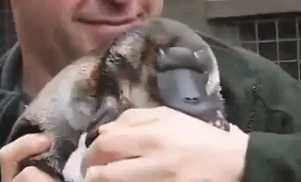
When scientists discover an unknown organism, they use features of the organism to classify it into a group.
When Europeans first discovered the platypus in Australia, they were mystified because it did not fit into any of the categories of animals that they knew.

Slide 4
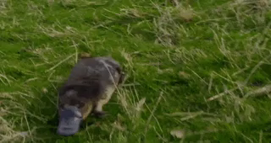
The platypus had webbed feet and a bill like a duck, but it did not have feathers.
It had fur like an otter, and lived both in and out of the water. It laid eggs like lizards, but suckled its young like mammals.
Eventually the platypus was classified into a separate order of mammals known as monotremes.

Slide 5
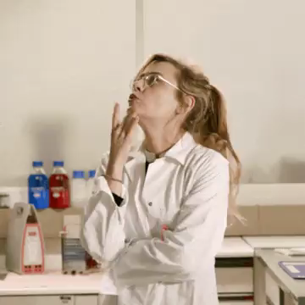
As seen with the platypus, classifying animals can be difficult!
To make things clearer, scientists often divide things with different features into groups. They do this by using a dichotomous key.

Slide 6
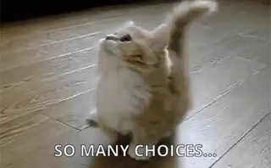
A dichotomous key is a series of choices that leads to the identification of an organism.
At each stage of using a dichotomous key, you are given two choices. Each choice leads to another choice until the organism is identified.

Slide 7
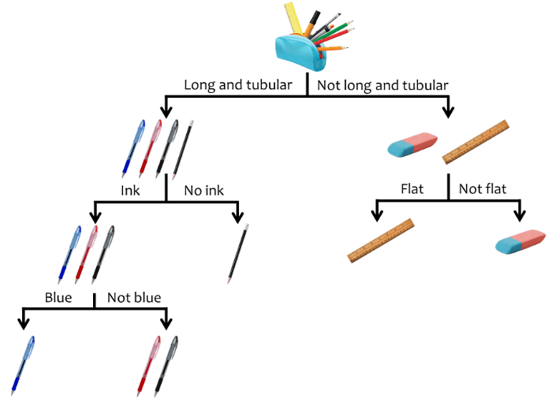
You probably use dichotomous keys every day without thinking about it!
For example, if you were trying to find a blue pen in your pencil case, you might follow the key below:

Slide 8
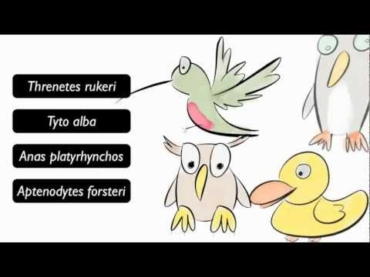

Slide 9
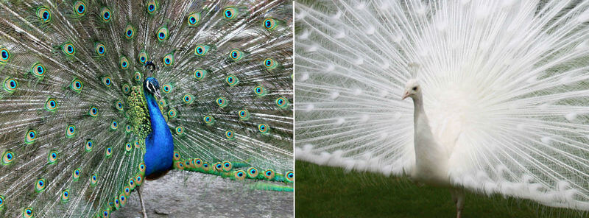
Some features of organisms are much better to use in a dichotomous key than others.
Structural features, like feathers, fur, or wings, are strong features in dichotomous keys, because they do not change over time or vary between organisms of the same species.
For example, both of these peacocks have long tail feathers and a crest on top of their heads, even though they are different colours.

Slide 10
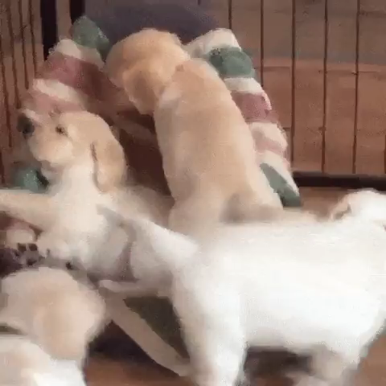
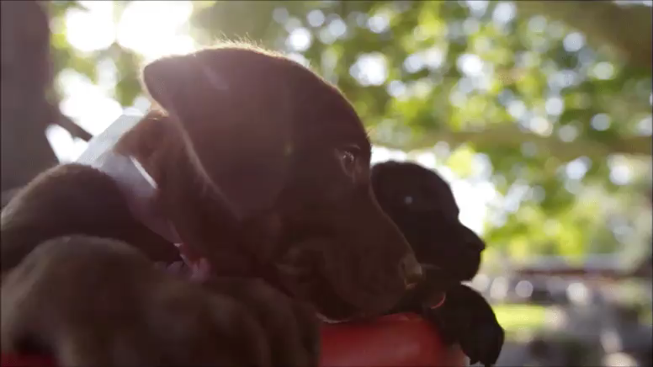
Size, colour, shape, behavioural and environmental features are weak features.
They are not the best features to use in a dichotomous key. This is because they could change over time or vary between organisms of the same species.
Golden, chocolate, and black Labrador retrievers are all members of the same species but they have different coloured coats!

Slide 11
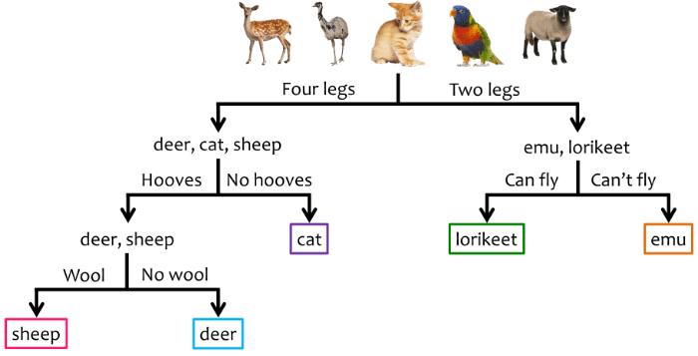
There are three different ways of presenting a dichotomous key.
However, they all show you the same thing! These are branching keys, tabular keys, and circular keys.
The key below is a branching key. Each choice is shown as a branch.

Slide 12
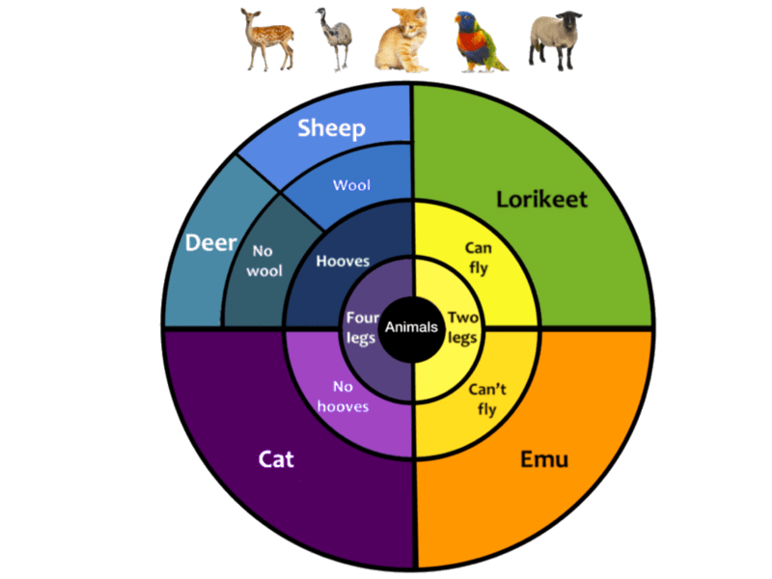
The same information can be represented in a circular key.
To use a circular key, start in the middle and move outwards, choosing one option at each layer. The organism can be identified in the final layer.

Slide 13
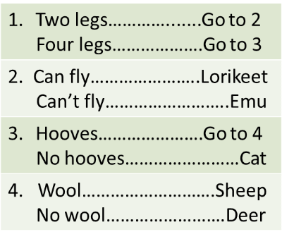
Tabular keys have the choices set out in a table, with each choice given a number.
To use a tabular key, start at step 1.
Follow the instructions at each step until the organism is identified.

Slide 14
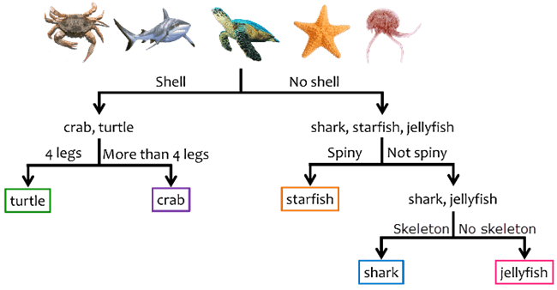

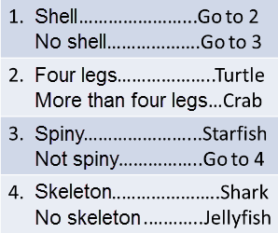
Branching and circular keys can be converted into tabular keys, and vice versa.

